Slide 1
BEST FIRST SEARCH

Slide 2

Combining the advantages of both depth-first and breadth-first search into a single method.
At each step we select the most promising of nodes we have generated so far.
This is done by applying an appropriate heuristic function to each of them.

Slide 3
Then expand the chosen node by using the rules to generate its successors.
We quit if one of them is a solution. If not, all those new nodes are added to the set of nodes generated so far.

Slide 4
Step 1
Step 2
A
A
B
C
D
(3)
(5)
(1)

Slide 5
Step 3
A
B
C
D
(3)
(5)
E
F
(4)
(6)

Slide 6
Step 4
A
B
C
D
(5)
G
H
E
F
(6)
(5)
(4)
(6)

Slide 7
Step 5
A
B
C
D
(5)
G
H
E
F
(6)
(6)
(5)
I
J
(2)
(1)

Slide 8
To implement a graph-search procedure, we will need to use two list of nodes
  OPEN :- nodes that have been generated and have had the heuristic function applied to them but which have not yet been examined.(i.e had their successors generated). These nodes have their g and h’ values and the parent link.
  OPEN is actually a priority queue in which the elements with the highest priority are those with the most promising value of heuristic function.

Slide 9
  CLOSED :- nodes that already have been examined. Each node contains the gvalue, h’value, parent link, and list of child nodes.
  We also need a heuristic function that estimates the merits of each node we generate. This will enable the algorithm to search more promising paths first.

Slide 10
Algorithm: Best-First Search
1.Start with OPEN containing just the initial state
2.Until a goal is found or there are no nodes left on OPEN do:
(a) Pick the best node on OPEN.
(b) Generate its successors.
(c) For each successor do:
(i) If it has not been generated before, evaluate it, add it to OPEN, and record its parent.

Slide 11
(ii) If it has been generated before, change the parent if this new path is better than the previous one.
In that case, update the cost of getting to this node and to any successors that this node may already have.

Slide 12
Heuristic function f’ is calculated as the sum of two costs g and h’.
G is the actual cost of getting to the node and h’ is the estimate of getting from the node to the goal state.
In problems where h’ is not available we can work with g alone. e.g:- shortest path problem (Dijkstra’s algorithm)

Slide 13
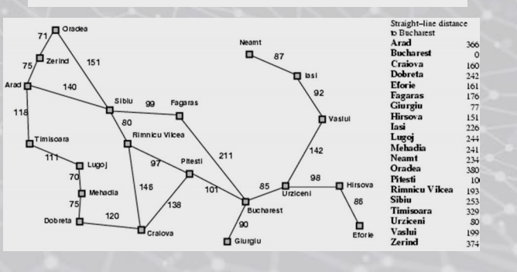

Slide 14
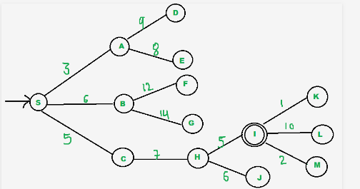

Slide 15
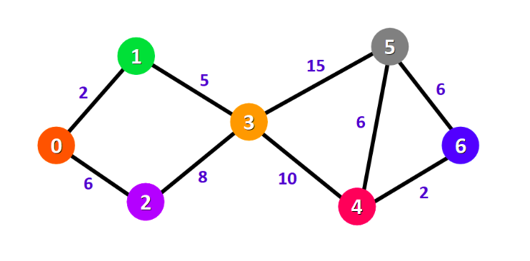
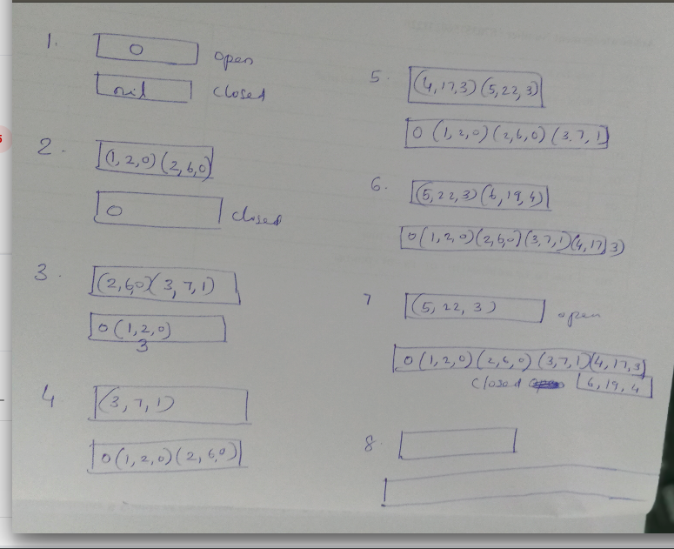

Slide 16
The A* algorithm
1 Place the starting node S on open.
2. If open is empty, stop and return failure.
3. Remove from open the node n that has the smallest value of f’(n).If the node is a goal node ,return success and stop.
4. Expand n, generating all of its successors n’ and place n on closed. For every successor n’, if n’ is not already on open or closed attach a back pointer to n, compute f’(n’) and place it on open.
5. Each n’ that is already on open or closed should be attached to back pointers which reflect the lowest g’ (n’) path if n’ was on closed and its pointer was changed, remove it and place it on open.
6. Return to step 2.

Slide 17
Problem Reduction
-When a problem can be divided into a set of sub problems, where each sub problem can be solved separately and a combination of these will be a solution, AND-OR graphs or AND - OR trees are used for representing the solution.
-The decomposition of the problem or problem reduction generates AND arcs.
-One AND arc may point to any number of successor nodes. All these must be solved so that the arc will rise to many arcs, indicating several possible solutions.
-Hence the graph is known as AND – OR.

Slide 18
Problem Reduction
Goal: Acquire TV set
Goal: Steal TV set
Goal: Earn some money
Goal: Buy TV set
AND-OR Graphs

Slide 19
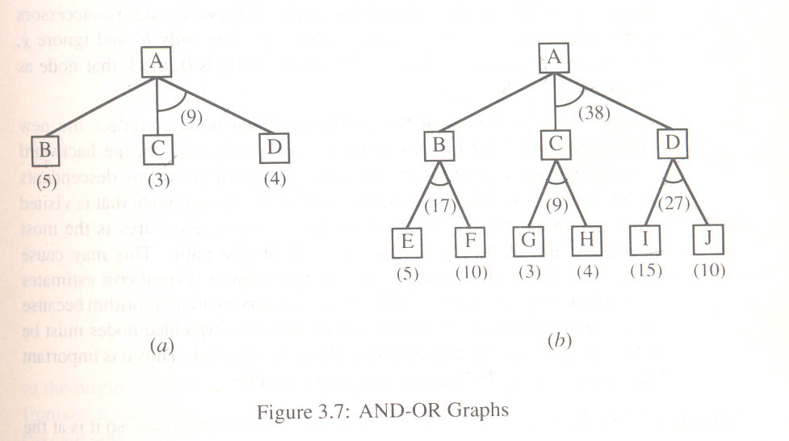
A* can't handle AND arcs properly

Slide 20
Problem reduction -Algorithm
. 1.Traverse the graph starting at the initial node and following the current best path, and accumulate the set of nodes that are on the path and have not yet been expanded.
2. Pick one of these unexpanded nodes and expand it. Add its successors to the graph and computer f ' (cost of the remaining distance) for each of them.
3. Change the f ' estimate of the newly expanded node to reflect the new information produced by its successors. Propagate this change backward through the graph. Decide which of the current best path.

Slide 21
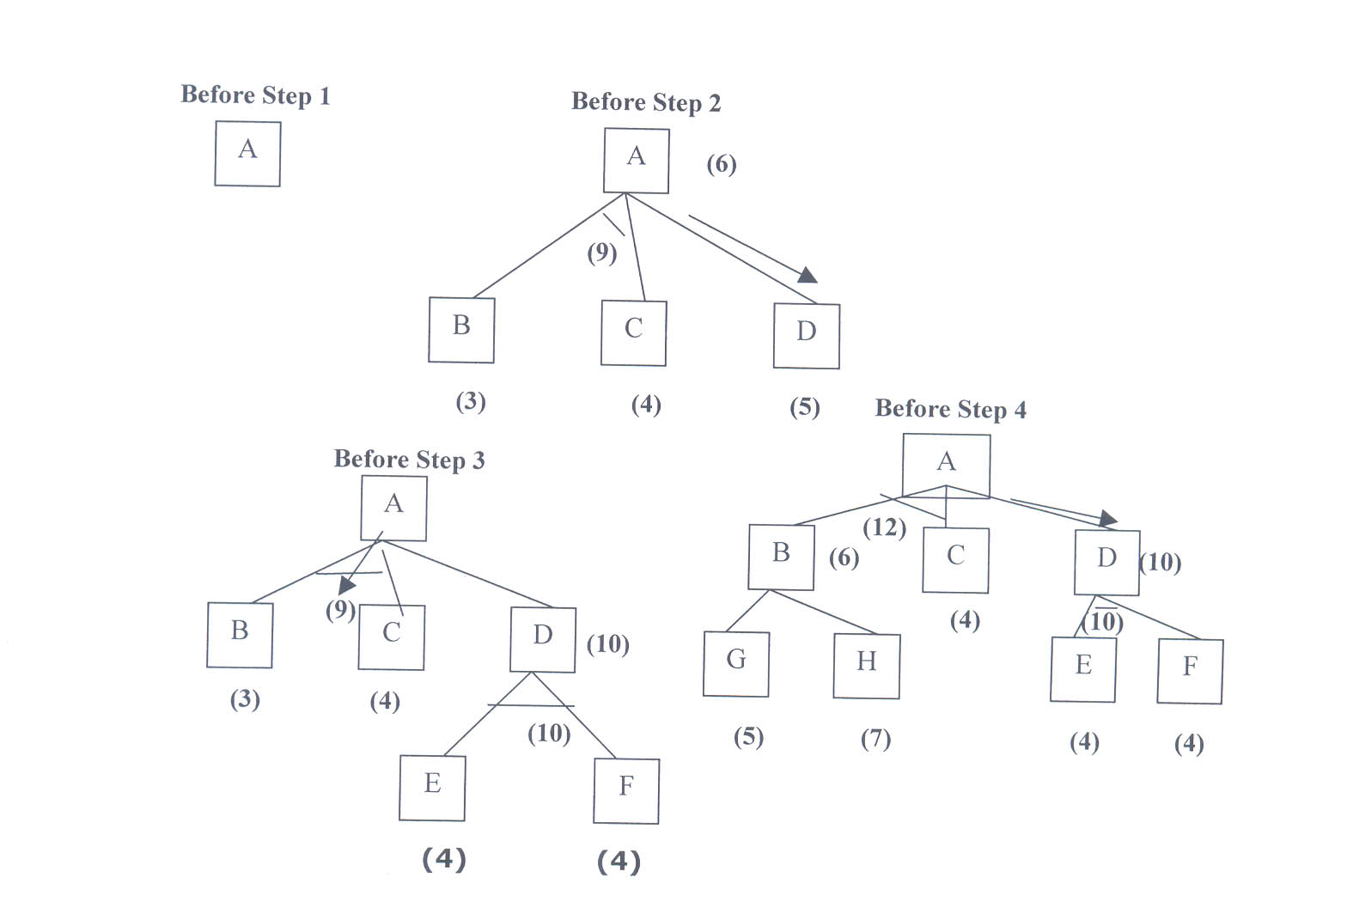
The operation of problem reduction
The initial node is expanded and D is marked initially as promising node.
D is expanded producing an AND arc E-F. f ' value of D is updated to 10. Going backwards we can see that the AND arc B-C is better . it is now marked as current best path.
B and C have to be expanded next.
This process continues until a solution is found or all paths have led to dead ends, indicating that there is no solution.
An A* algorithm the path from one node to the other is always that of the lowest cost and it is independent of the paths through other nodes.

Slide 22
AO* ALGORITHM
1.Let G consists only of the node representing the initial state .call this node INIT. Compute h' (INIT).
2. Until INIT is labeled SOLVED or h' (INIT) becomes greater than FUTILITY, repeat the
following procedure.
(I) Trace the marked arcs from INIT and select an unexpanded node NODE.
(II) Generate the successors of NODE . if there are no successors then assign FUTILITY as h' (NODE). This means that NODE is not solvable. If there are successors then for each one called SUCCESSOR, that is not also an ancestor of NODE do the following
(a) add SUCCESSOR to graph G
(b) if successor is a terminal node, mark it solved and assign zero to its h ' value.
(c) If successor is not a terminal node, compute it h' value.
(III) propagate the newly discovered information up the graph by doing the following . let S be a set of nodes that have been marked SOLVED. Initialize S to NODE. Until S is empty repeat the following procedure;
(a) select a node from S call it CURRENT and remove it from S
(b) compute h' of each of the arcs emerging from CURRENT , Assig minimum h' to CURRENT.
(c) Mark the minimum cost path a s the best out of CURRENT.
(d) Mark CURRENT SOLVED if all of the nodes connected to it through the new marked are have been labeled SOLVED.
(e) If CURRENT has been marked SOLVED or its h ' has just changed, its new status must be propagate backwards up the graph . hence all the ancestors of CURRENT are added to S.
*** AO* will always find minimum cost solution.

Slide 23
A* Vs AO*
Unlike A* algorithm which used two lists OPEN and CLOSED, the AO* algorithm uses a single structure G. G represents the part of the search graph generated so far. Each node in G points down to its immediate successors and up to its immediate predecessors, and also has with it the value of h' cost of a path from itself to a set of solution nodes.
The cost of getting from the start nodes to the current node "g" is not stored as in the A* algorithm. This is because it is not possible to compute a single such value since there may be many paths to the same state.
In AO* algorithm serves as the estimate of goodness of a node. Also a there should value called FUTILITY is used. The estimated cost of a solution is greater than FUTILITY then the search is abandoned as too expansive to be practical

Slide 24
Problem Reduction: AO*
A
11
A
14
B
13
C
10
B
13
C
15
D
5
E
6
F
3
D
5
E
6
F
3
G
5
G
10
Necessary backward propagation
H
9

Slide 25
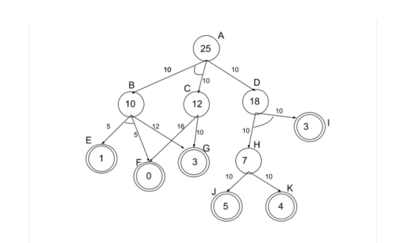

Slide 26
Means -Ends analysis
Most of the search strategies either reason forward of backward however, often a mixture o the two directions is appropriate. Such mixed strategy would make it possible to solve the major parts of problem first and solve the smaller problems the arise when combining them together. Such a technique is called "Means - Ends Analysis".
The means -ends analysis process centers around finding the difference between current state and goal state. The problem space of means - ends analysis has an initial state and one or more goal state, a set of operate with a set of preconditions their application and difference functions that computes the difference between two state a(i) and s(j).

Slide 27
Algorithm
MEA(CURRENT,GOAL)
1.Compare CURRENT to GOAL.If there are no differences between them then return it.
2.Otherwise ,select the most important difference and reduce it by doing the following until success or failure is signaled:
(a) Select an as yet untried operator O that is applicable to the current difference.If there are no such operators,then signal failure.
(b) Attempt to apply O to CURRENT.Generate descriptionsof two states :O-START,a stae in which O's preconditions are satisfied and O-RESULT ,the state that would result if O wer applied in O-START.
(c)If
(FIRST-PART<----MEA(CURRENT,O-START))
and
(LAST-PART <---- MEA(O-RESULT ,GOAL))
successful ,then signal success and return the result of concatenating
FIRST -PART, O , AND LAST-PART.

Slide 28
Robot problem
Find a sequence of actions robot performs
Move desk with two things on it from one location S to another G.
Operators are: PUSH, CARRY, WALK, PickUp, PutDown and PLACE.
Main difference :
Change of location of desk from initial position to goal position
Here objects on top must also be moved.
Data structure called ‘Difference Table’ indexes the rules by the differences that they can be used to reduce.

Slide 29
The Robots operators
Operator | Pre-conditions | Result
PUSH(obj, loc) | At(robot, obj) Λ Large(obj) Λ Clear(obj) Λ armempty | At(obj, loc) Λ At(robot, loc)
CARRY(obj, loc) | At(robot, obj) Λ Small(obj) | At(obj, loc) Λ At(robot, loc)
WALK(loc) | None | At(robot, loc)
PU(obj) | At(robot, obj) | Hold(obj)
PD(obj) | Hold(obj) | ~Hold(obj)
PLACE(Obj1, obj2) | At(robot, obj2) Λ Hold(obj1) | On(obj1, obj2)

Slide 30
Difference Table
 | PUSH | CARRY | WALK | PU | PD | PLACE
Move object | * | *
Move robot |  |  | *
Clear object |  |  |  | *
Get obj1 on obj2 |  |  |  |  |  | *
Get arm empty |  |  |  |  | * | *
Hold object |  |  |  | *

Slide 31
Cont…
Move Desk with two small bags on it from S to G.
To reduce this difference apply either CARRY or PUSH operator.
If CARRY is chosen first, then its preconditions be met.
This results in two more differences
  At(robot, desk) and Small(desk).
Here desk is not small, so CARRY can not be applied.
So choose PUSH which has four preconditions viz.,
  At(robot, desk) Λ Large(desk) Λ Clear(desk) Λ AE
Main important differences are only two i.e., At(robot, desk) Λ Clear(desk) and other two are common at start and goal positions.
S B________C G
Start PUSH Goal

Slide 32
Cont..
The differences between S and B can be reduced.
At(robot, desk) by WALK(desk_loc)
Clear(desk) by clearing two items on the desk.
  Clearing top can be done by two uses of PU operators.
  After one Pick up, an attempt to pickup second item results in another difference i.e., arm of robot be empty.
  This difference is reduced by PD operator.
So, we get sequence of following operators:
S(Start)_____________________________________B__________C
WALK(desk_loc)->PU(obj1)->PD(obj1)->PU(obj2)->PD(obj2) PUSH
Once PUSH is performed, problem state is close to goal state.
Now objects must be placed on the top of desk.

Slide 33
Cont...
The difference between C and G is achieved by PLACE operator.
S(Start)______________________________B_____ C E________G(Goal)
WALK->PU(obj1)->PD(obj1)->PU(obj2)->PD(obj2) -> PUSH PLACE
The final difference between C & E can be reduced by using WALK to get robot back to objects, followed by PU and CARRY operators. Final Plan is as follows:
→ WALK (start_desk_loc) → PU(obj1) → PD(obj1) → PU(obj2)→
WALK(start_desk_loc) ← PUSH(desk, goal_loc) ← PD(obj2)
→ PU(obj1) → CARRY(obj1,goal_loc) → PLACE(obj1,desk) →
PLACE(obj2,desk) ← CARRY(obj2, goal_loc) ← PU(obj2) ← WALK(start)

Slide 34
Constraint Satisfaction
Two kinds of rules:
1. Rules that define valid constraint propagation.
2. Rules that suggest guesses when necessary.

Slide 35
Initial state:
No two letters have
the same value.
The sum of the digits
must be as shown.
M = 1
S = 8 or 9
O = 0
N = E + 1
C2 = 1
N + R > 8
E ≠ 9
SEND
MORE
MONEY
+
E = 2
N = 3
R = 8 or 9
2 + D = Y or 2 + D = 10 + Y
C1 = 0
C1 = 1
2 + D = Y
N + R = 10 + E
R = 9
S =8
2 + D = 10 + Y
D = 8 + Y
D = 8 or 9
D = 8
D = 9
Y = 0
Y = 1

